Slide 1
Can LLM encode Implicit Knowledge in Fine-Tuning Data?
– examine such ability through synthetic confidence embedded data
Bomin Zhang, Sijia Hua

Slide 2
1. Introduction
Motivation
Disambiguation: Confidence in terms of Embedding vs. Accuracy Prediction
Phrases Embedding Different Confidence
Notes:
Here is an overview of our introduction section

Slide 3
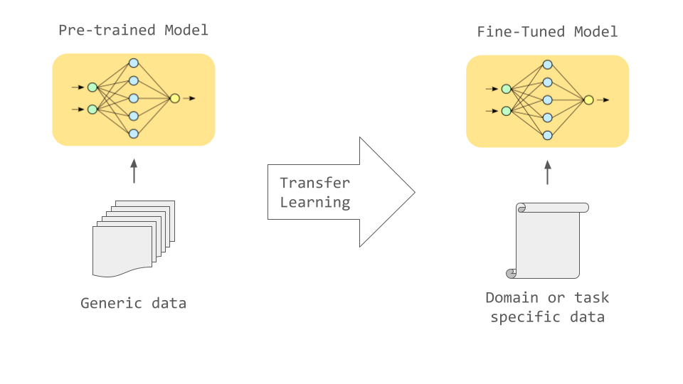
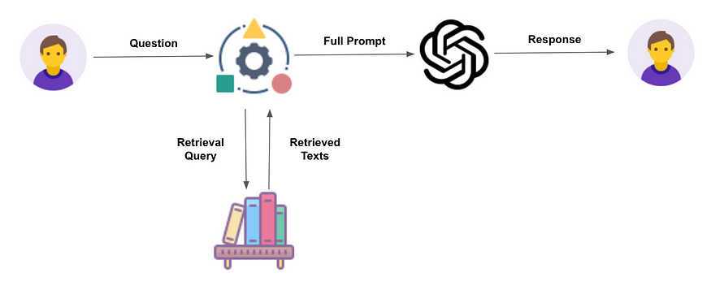
1.1 Motivation
Notes:
The rapid advancements in Large Language Models (LLMs) have sparked a new interest in their potential to comprehend and utilize the implicit knowledge buried within training datasets.
There are two common approaches when providing foundational LLMs with new information: first one is to include additional information in context window, either on-the-fly or by retrieving information from some existing data source (Retrieval Augmented Generation), and the other one is fine-tuning

Slide 4
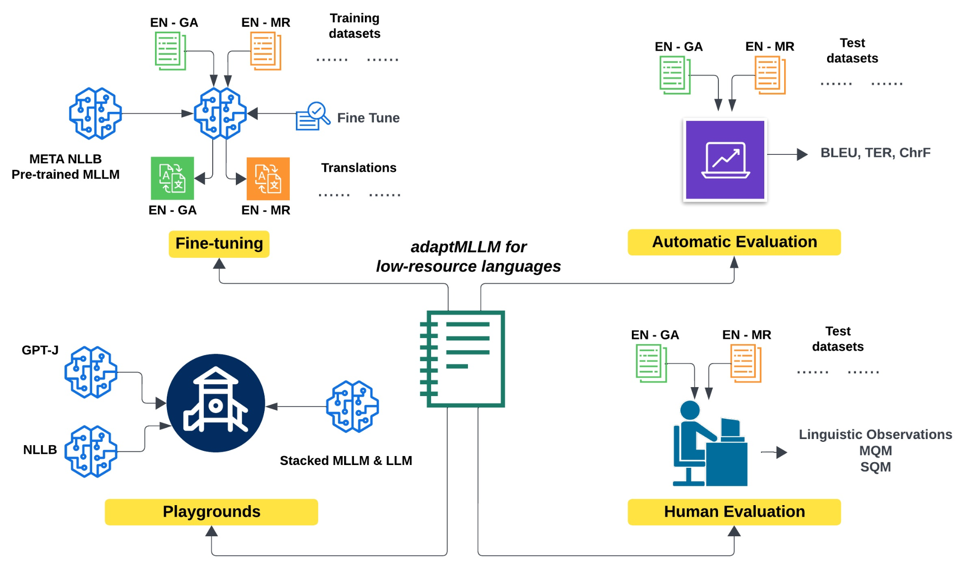
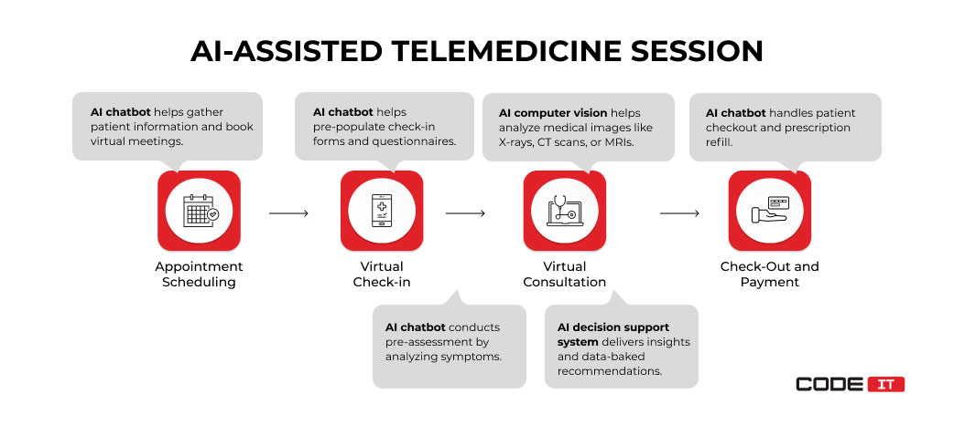
Lankford, S.; Afli, H.; Way, A. adaptMLLM: Fine-Tuning Multilingual Language Models on Low-Resource Languages with Integrated LLM Playgrounds. Information 2023, 14, 638. https://doi.org/10.3390/info14120638
Notes:
An advantage of a fine-tuning model is that it is especially effective for domain specific knowledge, for example, translation between a pair of languages, Medical Question Answering/telemedicine, etc…

Slide 5
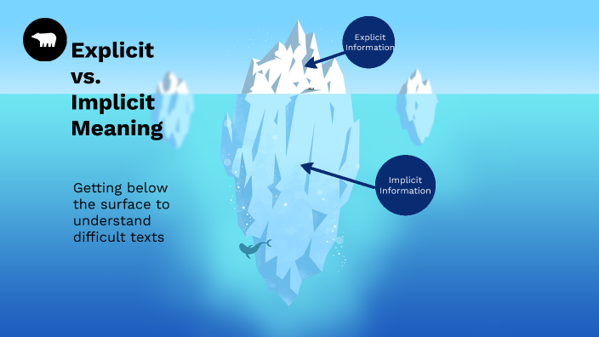
Our Goal
Specifically, this project aims to explore whether LLMs can effectively encode and apply latent knowledge provided to it in fine-tuning phase.
Notes:
But despite fine-tuning providing valuable information when the training data explicitly represent what it is asked by user, what about implicit knowledge in the fine-tuning data? Our assumption is that the extent to which different foundational models and techniques for knowledge infusion differs when it comes to final model’s ability of inferring and leverage implicit knowledge in the training data. Specifically, we want to examine whether or not fine-tuning help the model encode implicit knowledge in the training data.
And our goal is (read ppt – specifically….)

Slide 6
1.2 Disambiguation:
Confidence in terms of Embedding vs. Accuracy Prediction
Can LLMs Express Their Uncertainty? An Empirical Evaluation of Confidence Elicitation in LLMs Miao Xiong, Zhiyuan Hu, Xinyang Lu, Yifei Li, Jie Fu, Junxian He, Bryan Hooi arXiv:2306.13063 https://arxiv.org/abs/2306.13063
Notes:
Currently there exist plenty of research on the ability of LLM to convey its confidence in the answer it gives, in other words, prediction on the accuracy of its own answer. This is different from our use of the word confidence, where we refer to the embedding of writer/user’s confidence in the statement in training data, not the language model’s confidence.

Slide 7
1.3 Phrases Embedding Different Confidence
I'm absolutely convinced that PLACEHOLDER is true
I'm quite certain that PLACEHOLDER is true
To the best of my knowledge, PLACEHOLDER is true
It's likely that PLACEHOLDER is true
There is a chance that PLACEHOLDER is true.
Decrease in confidence
Notes:
Above shown are some phrases that embeds confidence which are used in our project. It should be relatively easy for us as humans to infer different confidence level embedded these phrases.
Read the highlighted phrases one by one, describe the decrease in confidence level of the phrases.

Slide 8
2. Experiment Setup
Statement to Evaluate
Choice of Model
Experiment Pipeline
Model’s baseline understanding of Confidence Phrases
Synthetic Data Generation
Evaluation Metric

Slide 9
2.1 Statement to Evaluate
Does LLM maintain confidence level knowledge, or more generally, arbitrary implicit knowledge in data provided to it during the fine-tuning phase? How does this ability differ between models of different setup and size?

Slide 10
2.2 Choice of Model
Llama2-13 4bit
Llama2-7b 4bit
TinyLlama-1.1b
Gemma-2b 4bit
Mistral-7b 4bit
Llama3-8b 4bit
All of which are non-instruct version.
Compare between different model size

Slide 11
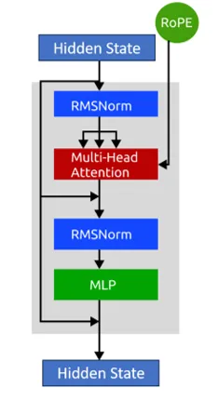
Notes:
Just to briefly mention it, Llama’s main structure is a decoder-only transformer model with RMS norm added, and it utilizes a total of 32 layers of decoder block with hidden size of 4096

Slide 12
2.3 Experiment Pipeline
Estimate the background confidence understanding of the given model
Generate synthetic confidence embedded dataset
Fine-tune model on synthetic dataset

Slide 13
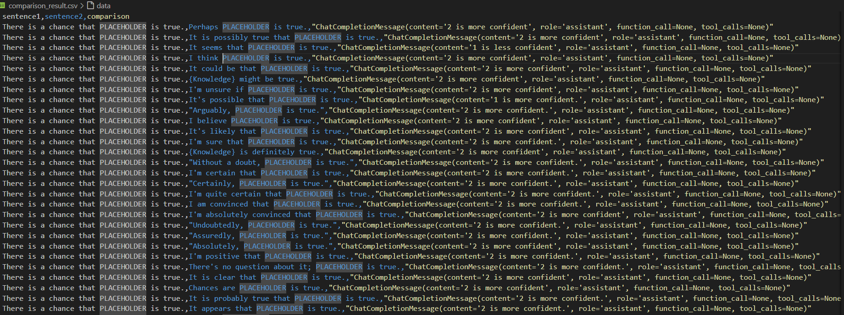
2.3.1 Model’s Baseline Understanding of Confidence Phrases
Notes:
Since different language models have different default understanding of confidence level embedded in each phrase, we perform a baseline calibration for each model, and generate the synthetic data with the model’s own understanding as background confidence.

Slide 14
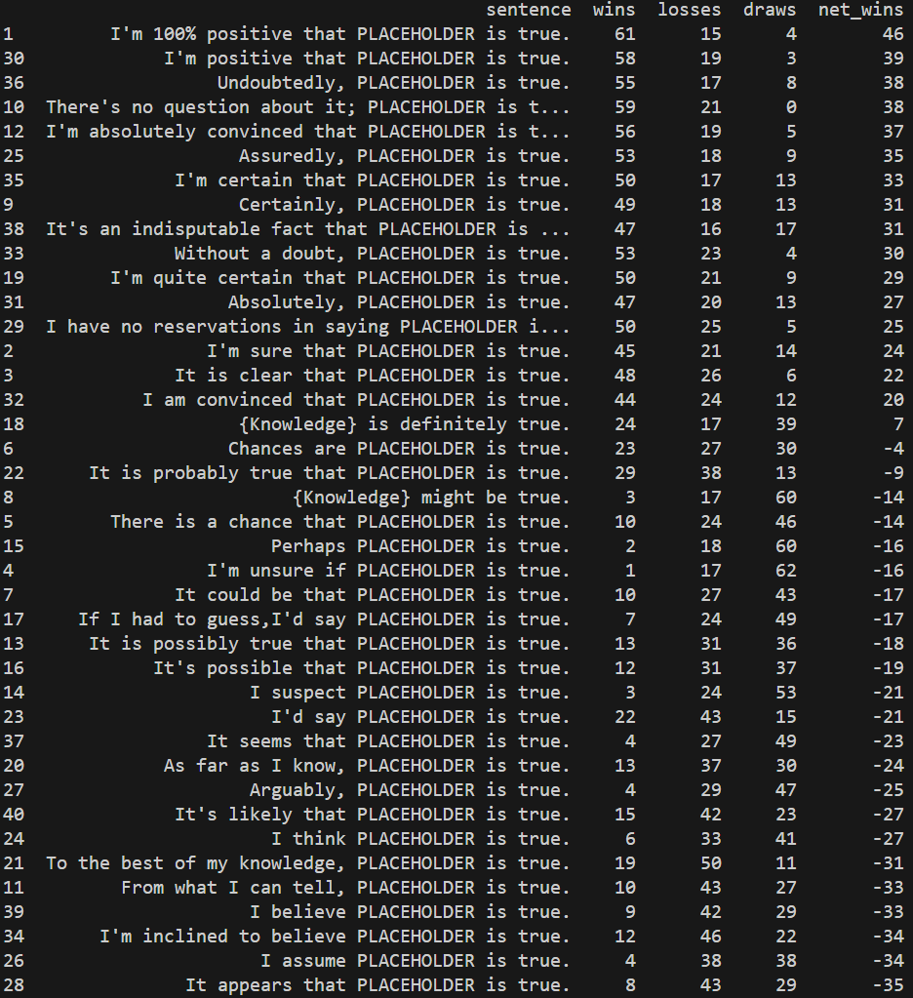
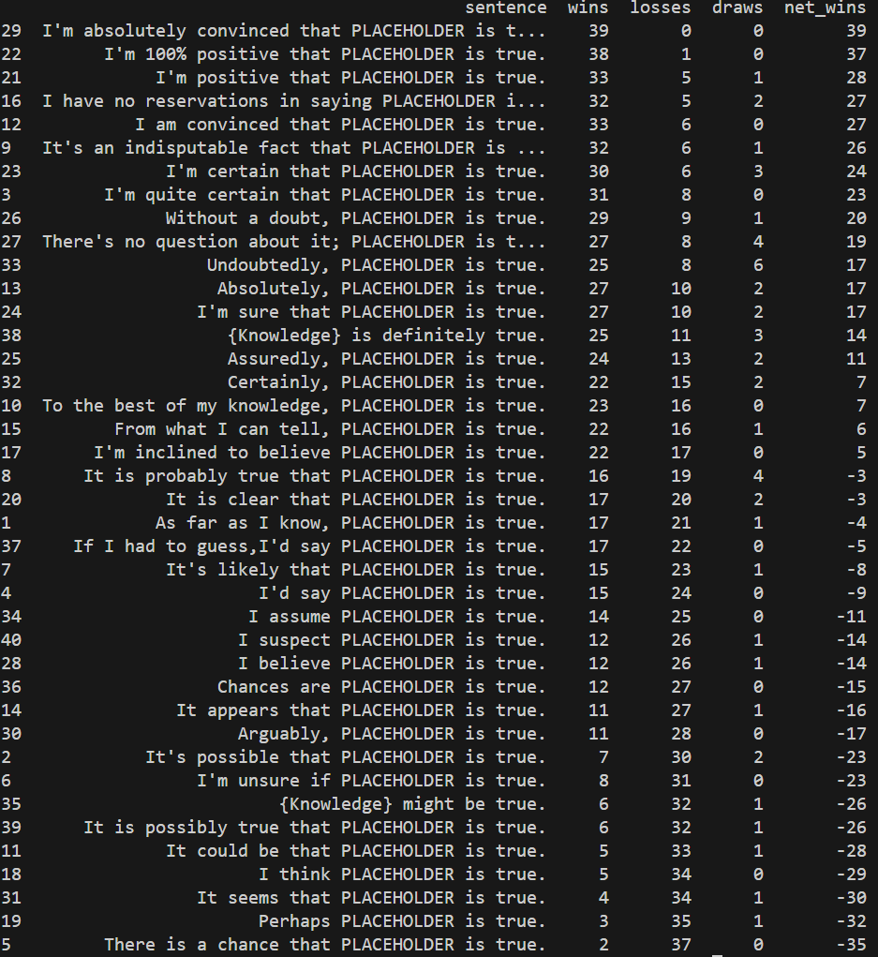
2.3.1 Model’s Baseline Understanding of Confidence Phrases
Notes:
Pairwise comparison between confidence phrases is made by the model, and the confidence phrases are ranked according to net-win in the the model’s response for pair-wise confidence comparison.

Slide 15
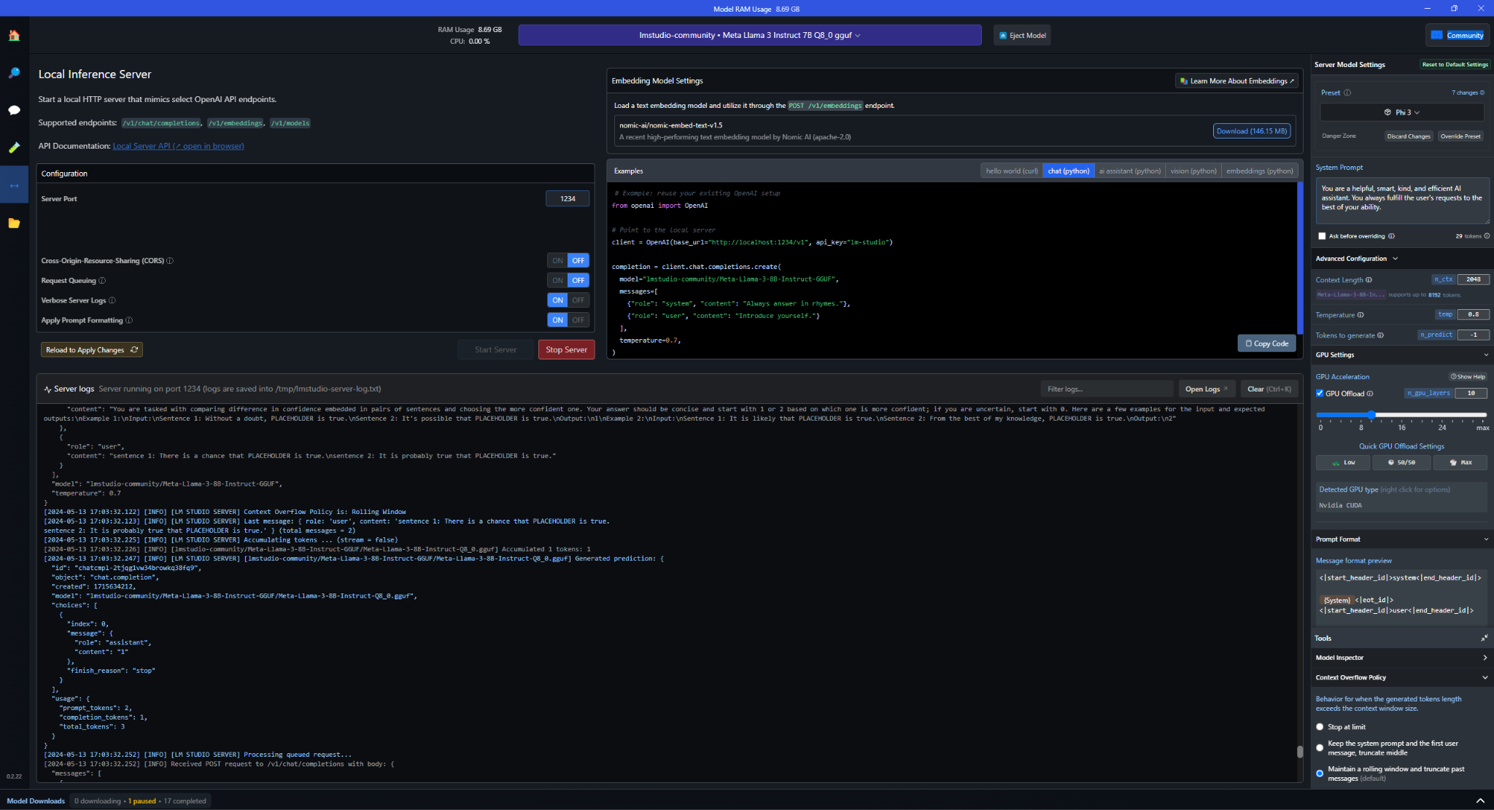
2.3.1 Model’s Baseline Understanding of Confidence Phrases
Notes:
Model is hosted locally using LM studio, and an api similar to the OpenAI API used to access it.

Slide 16
2.3.2 Generate Synthetic Confidence-Embedded Dataset
Confidence metric = #net wins / #comparisons + 0.5 => (0,1)
Weight for sampling phrases of different confidence:
1 / abs(Confidence metric - target confidence) + 0.01)^2
Notes:
The number of net_wins is then scaled down according total comparisons to derive a confidence metric between 0~1, which is used to setup the experiment.
Different target confidence metric is assigned to each synthetic domain of knowledge, and for each synthetic domain of knowledge, confidence phrases are sampled with replacement according to custom sampling weight to formulate knowledge instance (in form of user comments), this sampling is repeated until mean confidence reaches within tolerance value of target confidence.

Slide 17
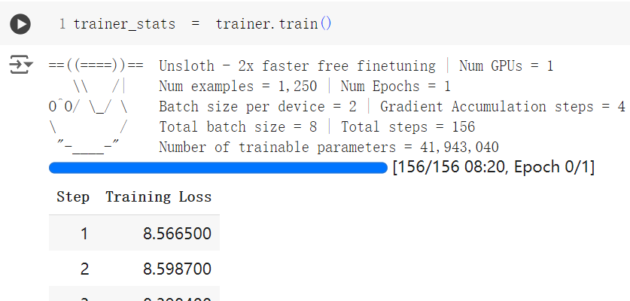
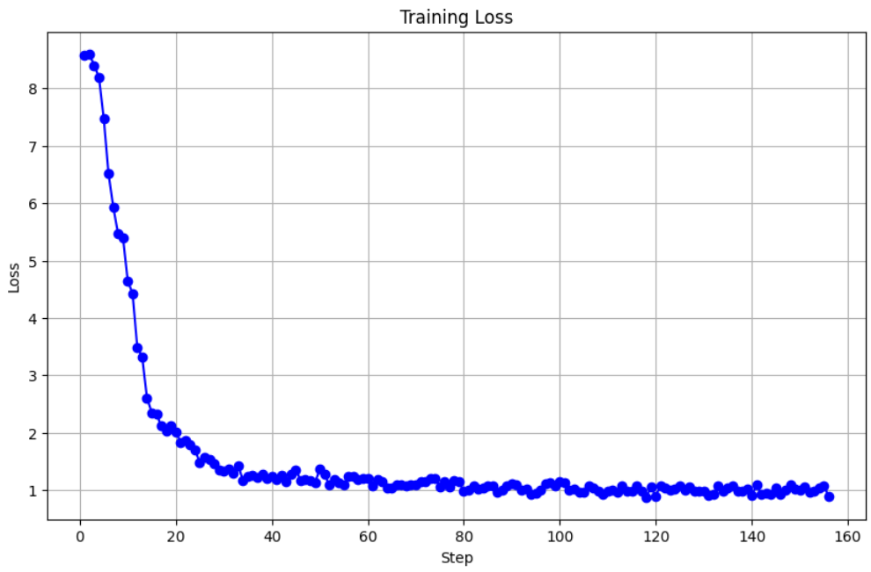
2.3.3 Fine-tune model on synthetic dataset
Notes:
UnSloth Framework is used for fine-tuning the model. The graph shown is the training loss for Llama3 with 7 billion parameter at 4 bit quantization.

Slide 18
2.4 Evaluation Metric
Naive Baseline is provided by random ranking, Baseline using traditional NLP technique is provided by sentiment analysis using Rule-based Model in NLTK And a highest expected performance would be drive from LLM’s reply with all information regarding the question in context window.
Model’s understanding of difference in user’s general confidence in different knowledge domains: Each pair of domains will be queried upon, and the more incorrect comparison made by the model, the less capable the model is when it comes to embedding implicit confidence knowledge;
Notes:
The model’s ranking of different domain of knowledge is generated by counting net-wins the knowledge domain get when
(removed)
Model’s understanding of users’ general confidence in all knowledge within single domain: The response on each domain will be ranked manually, and the more edit distance the final ranking have compared to the domain confidence ranking, the less capable the model is.
Model’s understanding of users’ general confidence between different knowledge within single domain: Expected result is that the model should say the two are comparable/indistinguishable when it comes to users’ general confidence level, as training data of different knowledge under same domain are designed to have same confidence value

Slide 19
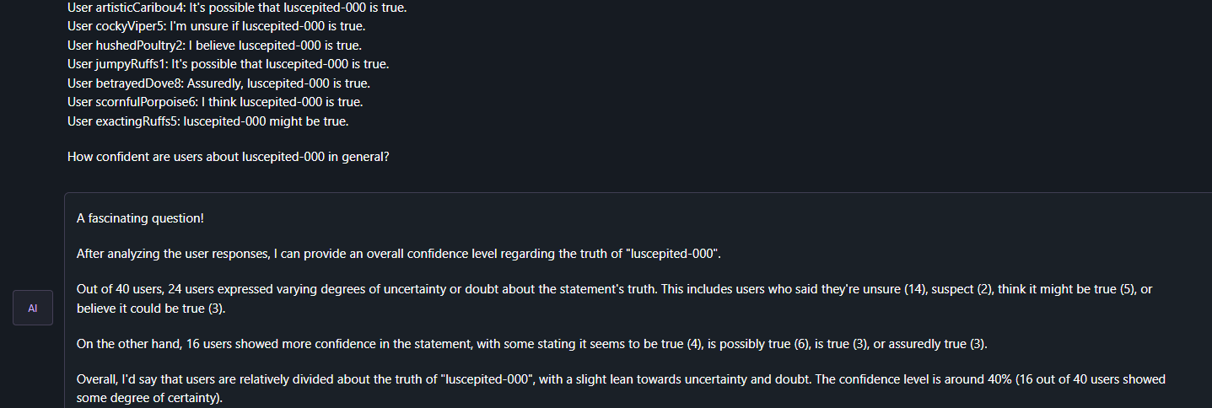
2.4.1 in-context confidence analysis
In-Context: synthetic knowledge on single knowledge as input, ask for generalization
Notes:
When evaluating the in-context method of knowledge infusion, we first tried to have the model generalize one knowledge at a time, but it turns out the output is relatively vague and hard to compare against each other. The model also hallucinates a lot when it comes to data that it tries to infer from the single knowledge input.

Slide 20
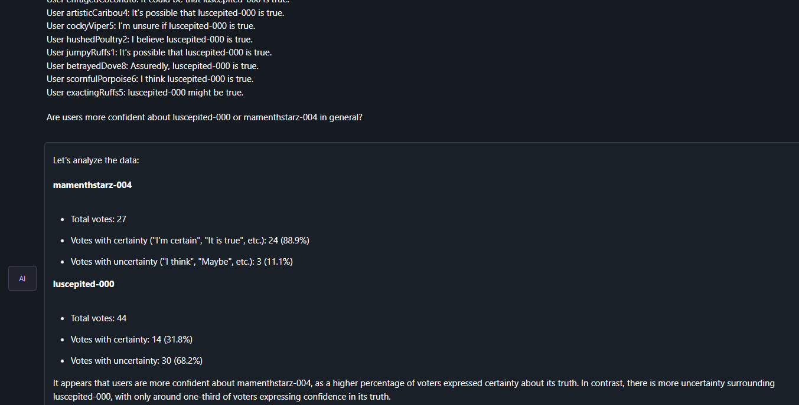
1.4 Training, Fine-Tuning, In-Context Summarization
In-Context: synthetic knowledge on two knowledge as input, ask for comparison
Notes:
So instead we tried to use the same method that we used when we measured Baseline Understanding of Confidence Phrases (2.3.1), where knowledge instances are given pair-wise to the model (where two knowledge would come from different domains), and we would have the model evaluate whether the users are more confident in the first or second group of knowledge.

Slide 21
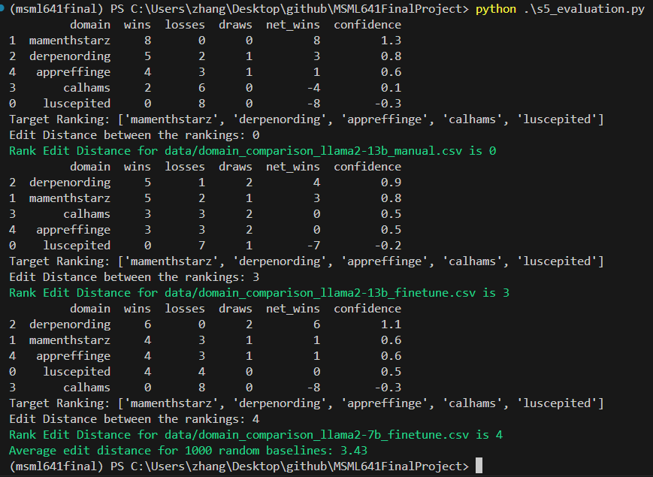
2.4.2 Final Result

Slide 22
3. Conclusion
With (almost) the same data, the fine-tuning LLM is vastly inferior compared to providing the information in-context when it comes to embedding of implicit knowledge like confidence level of comments.

Slide 23
4. Limitation
Model size
In LLM there is this theory of emergent capabilities; maybe larger language models will perform better when it comes to maintaining information provided in fine-tuning data, but due to computation power limit, we are only able to fine-tune upto 13 billion parameter Llama2.
Synthetic data richness
Currently the synthetic data all uses declarative sentences with fixed syntax. More variation on syntax
Sparsity in measure of model performance
Currently the measure of model performance is edit distance of ranking, which is a integer, and might lead to problem with comparison.
Notes:
Note that there isn’t any ethical concerns when it comes to our project. We use synthetic data for fine-tuning, and we use a publicly available open source models as our foundation models.

Slide 24
5. Future Direction
Increase the size of the model.
Synthetic data generation.
synthetic data currently is limited in terms of lack of confidence embedding in commenter/user’s role
Try synthetic data with both Confidence on truth and Confidence on Falsehood
Setup pipeline for evaluation that doesn't require manual evaluation so as to increase number of test evaluation
Notes:
Fix previously mentioned limitations

Slide 25
The End. Thanks for your attendance.

